Slide 1


Presentation on GRAMIN DIGITAL SOLUTION
OF
Masters of Computer Applications
By
Under The Guidance Of-
SUBMITTED BY
SANNI RAJ
Roll.No-20MC513912
Reg.No-DSPMU2020003907
Department of Information Technology -MCA

Slide 2
1. Gramin Digital Solution
The main purpose of our website is that we will give all the information about such areas which are deprived of development facilities.
Deprived of many government facilities, such as electricity, roads, education, health facilities, drinking water supply.
With the help of this website, people of rural areas can show the problems of their area through the help of photos and videos.

Slide 3
1.1 Purpose, Scope & Objective
Purpose
To solve the problems which is negleted by the senior authorities.
To promote and make the system partial.
Scope
To help and educate the people about online system.
To reduce the issue if rural and as well as urban area.
Objective
The correct information about the development works will be given by the people of that area through Social Media app.
It will direct accesible by senior level authorities.

Slide 4
1.3 Benefits
It increases the efficiency of the management at offering quality services to the citizens.
The software acts as help portal that is open 24/7.
Help to citizens and local people to recah out their desired requirement in very short time period..
It will make system partial with the government as well as local citizens and higher authorities.

Slide 5
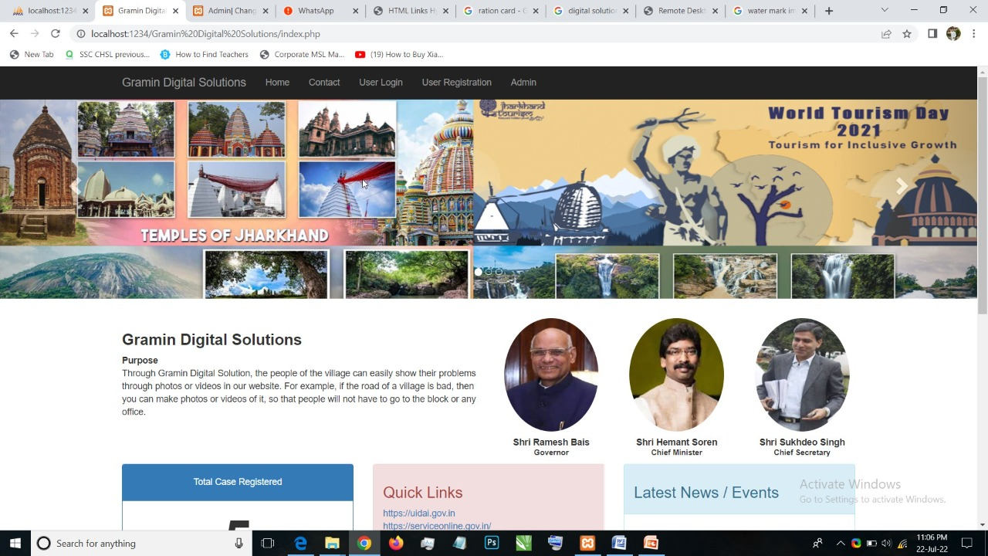
2. Let’s visit Website interface

Slide 6
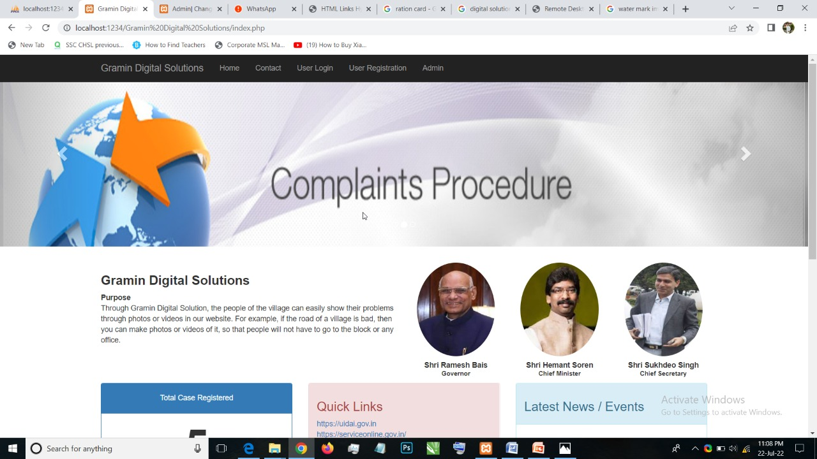
2. Let’s visit Website interface

Slide 7
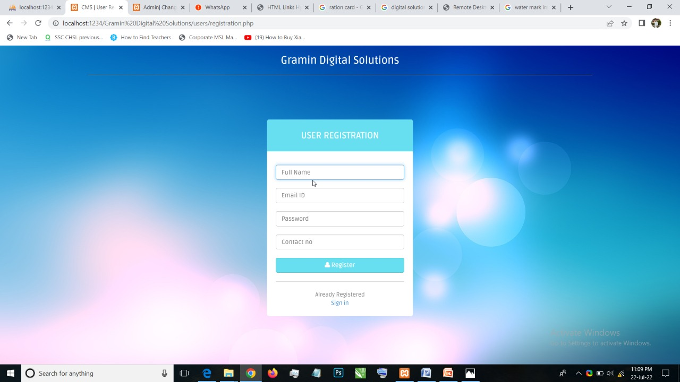
2.1 User Registration
New User Login Here

Slide 8
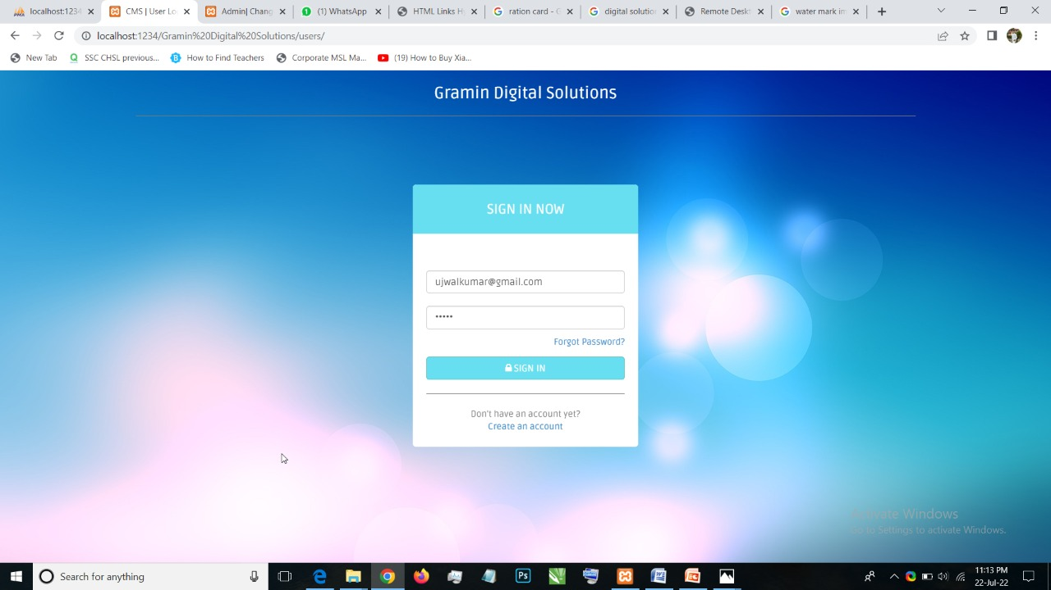
2.1 Login / Sign In :
Login with registered id and pss.

Slide 9
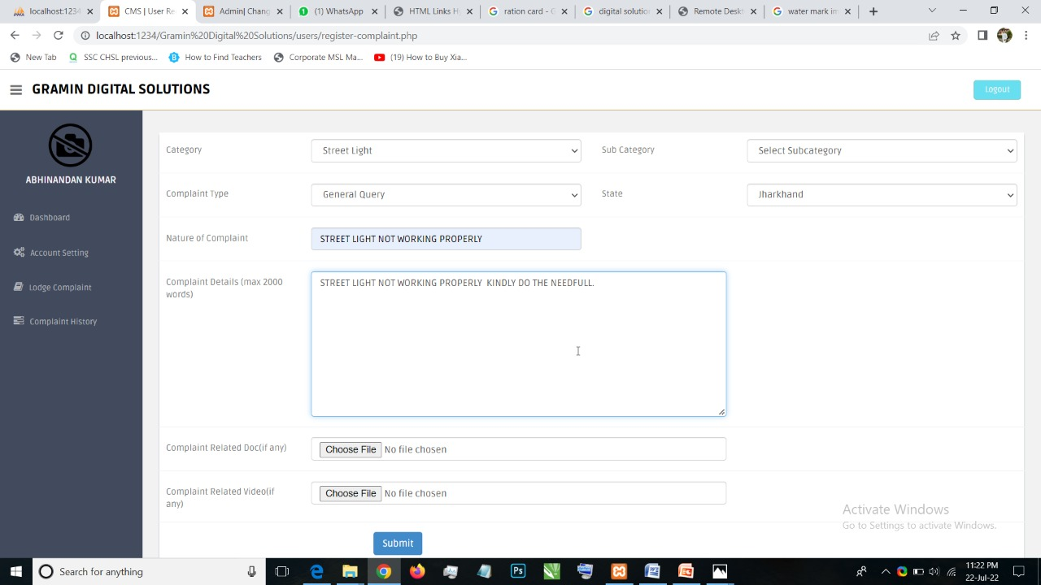
2.2 Post a query :
Fill the Details and Post a query.

Slide 10
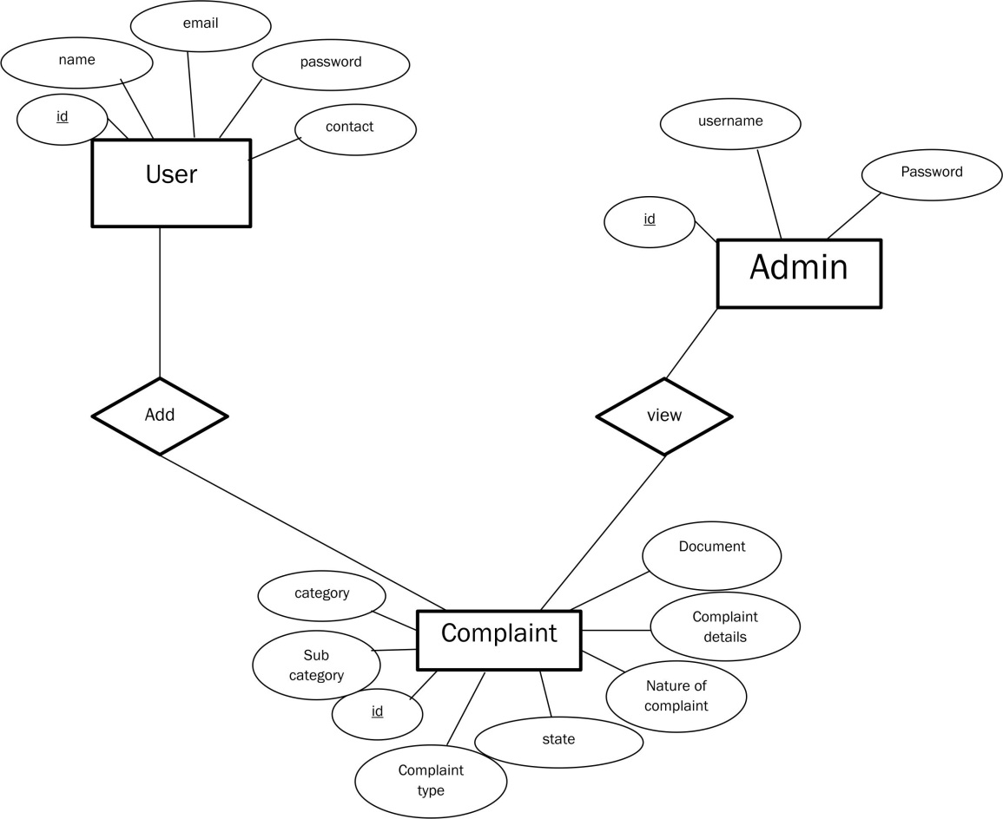
Interconnection Of User And Admin:

Slide 11
Refrence:
There are many existing Systems, which work same as propsed system.
Freshdesk
Zoho Desk

Slide 12
Hardware & Software Requirements:
The minimum Configuration Required to run this project are:
.
Hardware Requirements
Processor | Hard-disk | Memory
I3 or more | 50 GB & more | 1GB & more
Software Requirement
Operating system | Database | Software
Window latest version or Old version. | MySQL | Sublime text 3,Wamp Server

Slide 13
.
Thank You.

